Slide 1
Reimbursement for 911 Services: Medical Necessity in the Context of Emergency Ambulance Responses
Brian S. Werfel, Esq.
TASA 2018 Reimbursement/Compliance Conference
October 18, 2018

Slide 2
Medically Necessary?

Slide 3
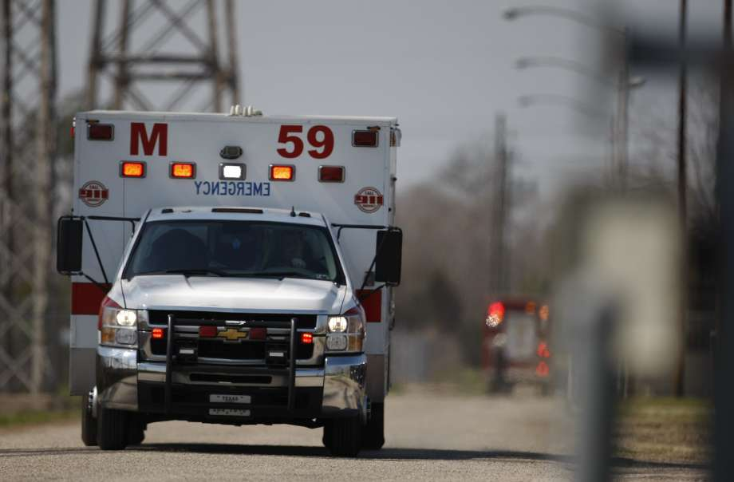
Misconception #1
All calls dispatched through the 911 system qualify as “emergencies”

Slide 4
Standards for an “Emergency”
Two general standards
“Prudent Layperson” Standard
“Immediate Response” Standard

Slide 5
Prudent Layperson Standard
42 C.F.R. §438.114
Emergency medical condition means a medical condition manifesting itself by acute symptoms of sufficient severity (including severe pain) that a prudent layperson, who possesses an average knowledge of health and medicine, could reasonably expect the absence of immediate medical attention to result in the following:
Placing the health of the individual (or, for a pregnant woman, the health of the woman or her unborn child) in serious jeopardy.
Serious impairment to bodily functions
Serious dysfunction of any bodily organ or part

Slide 6
History of the Prudent Layperson Standard
First adopted by State of Maryland in 1993
In 1994, Congress revised EMTALA to incorporate the prudent layperson definition as the standard for determining when a patient has an emergency condition
Balanced Budget Act of 1997 established the prudent layperson standard for Medicaid Managed Care Organizations (effective October 1997) and Medicare (May 1998)
Extended to all federal health plans in 1998 by Executive Order
Adopted by the VA in November 1999, as part of the Veteran’s Millennium Health Care and Benefits Act
Affordable Care Act adopted the standard for all ERISA plans and all qualifying exchange plans

Slide 7
Practical Impact of Prudent Layperson Standard
Bases coverage for ED visits - - and, by extension, ambulance transportation - - on a patient’s presenting symptoms, rather than the final diagnosis

Slide 8
Immediate Response Standard
42 C.F.R. §414.605
“Emergency response” means responding immediately at the BLS or ALS1 level of service to a 911 call or the equivalent in areas without a 911 call system. An immediate response is one in which the ambulance entity begins as quickly as possible to take the steps necessary to respond to the call.

Slide 9
Chapter 10 of Medicare Benefit Policy Manual
Emergency Response Definition:
Emergency response is a BLS or ALS1 level of service that has been provided in immediate response to a 911 call or the equivalent. An immediate response is one in which the ambulance provider/supplier begins as quickly as possible to take the steps necessary to respond to the call.

Slide 10
Chapter 10 of Medicare Benefit Policy Manual
Application: The phrase “911 call or the equivalent” is intended to establish the standard that the nature of the call at the time of dispatch is the determining factor. Regardless of the medium by which the call is made (e.g., a radio call could be appropriate) the call is of an emergent nature when, based on the information available to the dispatcher at the time of the call, it is reasonable for the dispatcher to issue an emergency dispatch in light of accepted, standard dispatch protocol. An emergency call need not come through 911 even in areas where a 911 call system exists. However, the determination to respond emergently with a BLS or ALS ambulance must be in accord with the local 911 or equivalent service dispatch protocol.

Slide 11
Misconception #2
All emergency transports are medically necessary

Slide 12
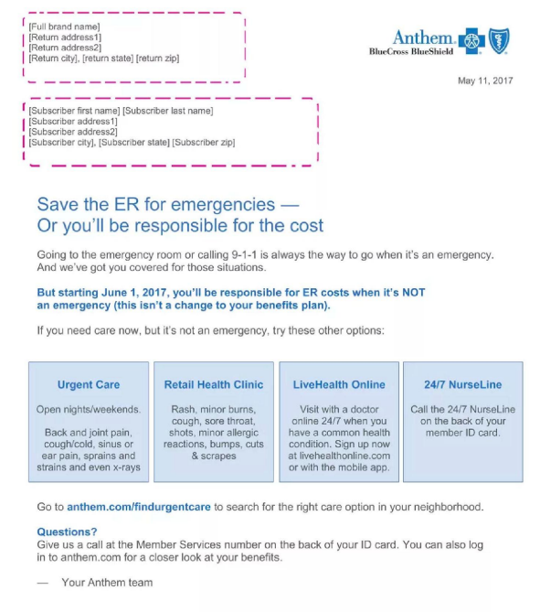

Slide 13
Anthem’s Policy
As noted earlier, the intent of the Prudent Layperson Standard is to base coverage for emergency services on the patient’s symptoms, not their final diagnosis
By contrast, Anthem is basing its coverage on the ultimate diagnosis of the patient’s condition (as evidenced by the ICD-10 code assigned to the hospital claim)
Anthem is using that same diagnosis to determine coverage for any associated emergency ambulance claim

Slide 14
Medicare Coverage
Since the adoption of the Medicare Ambulance Fee Schedule in 2002, Medicare has bifurcated the issue of coverage (i.e., medical necessity) from the issue of the level of service (i.e., emergency v. non-emergency)

Slide 15
Chapter 10 of Medicare Benefit Policy Manual
Emergency Response Definition:
The nature of an ambulance’s response (whether emergency or not) does not independently establish or support medical necessity for an ambulance transport. Rather, Medicare coverage always depends on, among other things, whether the service(s) furnished is actually medically reasonable and necessary based on the patient’s condition at the time of transport.

Slide 16
Chapter 10 of Medicare Benefit Policy Manual
Section 20
The A/B MAC (A) or (B) presumes the requirement was met if the submitted documentation indicates that the patient:
• Was transported in an emergency situation, e.g., as a result of an accident, injury or acute illness, or
• Needed to be restrained to prevent injury to the beneficiary or others; or
• Was unconscious or in shock; or
• Required oxygen or other emergency treatment during transport to the nearest appropriate facility; or
• Exhibits signs and symptoms of acute respiratory distress or cardiac distress such as shortness of breath or chest pain; or
• Exhibits signs and symptoms that indicate the possibility of acute stroke; or
• Had to remain immobile because of a fracture that had not been set or the possibility of a fracture; or
• Was experiencing severe hemorrhage; or
• Could be moved only by stretcher; or
• Was bed-confined before and after the ambulance trip.

Slide 17
For Medicare claims, the presence of an emergency medical condition creates a presumption of coverage, i.e., the burden shifts to the MAC to produce evidence that the patient could, in fact, have been transported safely by other means
content

Slide 18
2016 Medicare Claims Payment Data
Nationwide, less than 1% of all claims submitted with an emergency base rate (A0427, A0429, or A0433) are submitted to Medicare for a denial
>95% of enrolled Medicare ambulance suppliers did not bill a single emergency claim for a denial in 2016

Slide 19
ALS Assessment
Definition:
An ALS assessment is an assessment performed by an ALS crew as part of an emergency response (as defined below) that was necessary because the patient's reported condition at the time of dispatch was such that only an ALS crew was qualified to perform the assessment. An ALS assessment does not necessarily result in a determination that the patient requires an ALS level of service. In the case of an appropriately dispatched ALS Emergency service, as defined below, if the ALS crew completes an ALS Assessment, the services provided by the ambulance transportation service provider or supplier shall be covered at the ALS emergency level, regardless of whether the patient required ALS intervention services during the transport, provided that ambulance transportation itself was medically reasonable and necessary, as defined in section 10.2, above and all other coverage requirements are met.

Slide 20
Importance of Dispatch Protocols
Established dispatch protocols drive the determination as to whether a paramedic was warranted to assess the patient!!
All-ALS Services
Your protocols must distinguish between:
Situations where an ALS vehicle is sent based on the expected needs of the patient
Situations where an ALS vehicle is sent solely because of the mandate
i.e., if you were a 2-tiered system, would you still be sending an ALS vehicle?

Slide 21
MPD Codes

Slide 22
Misconception #3
We have a local ordinance that requires us to transport any patient that expresses a desire to be transported for a medical evaluation. The fact that we must transport these patients by ambulance establishes that all other means of transport were contraindicated

Slide 23
content

Slide 24
Case Study #1

Slide 25
Case Study #2

Slide 26
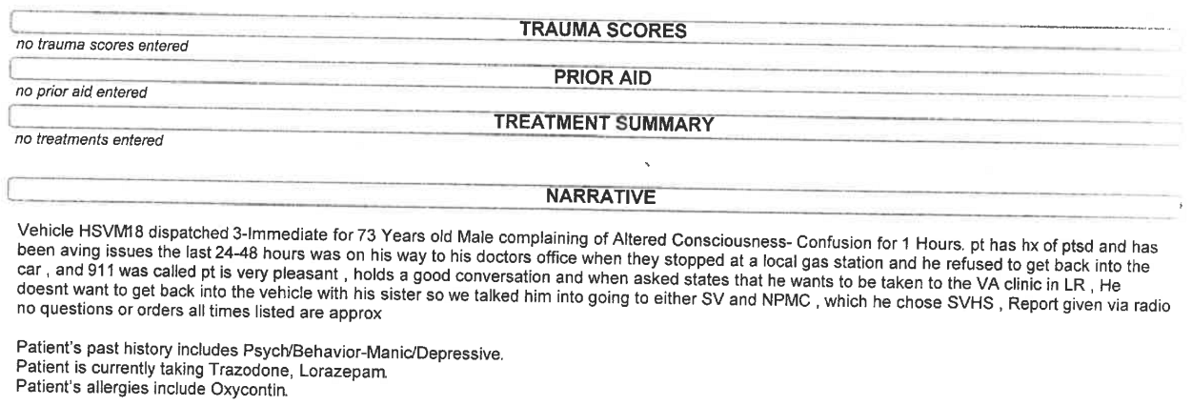
Case Study #3

Slide 27
Case Study #4

Slide 28
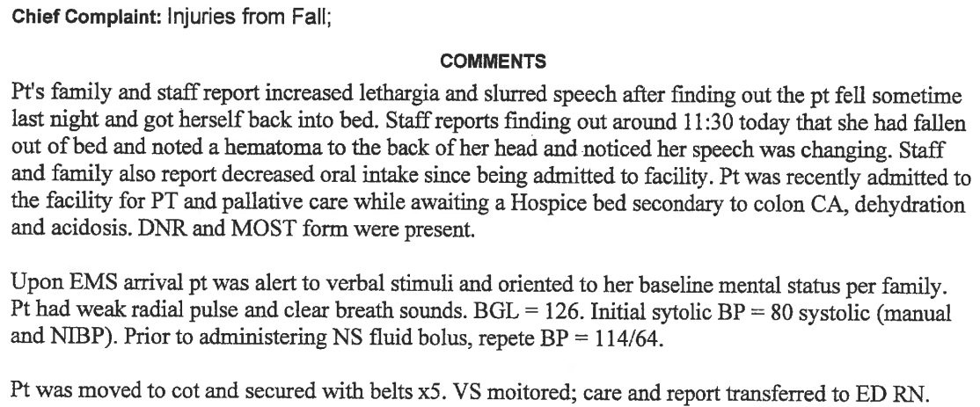
Case Study #5

Slide 29
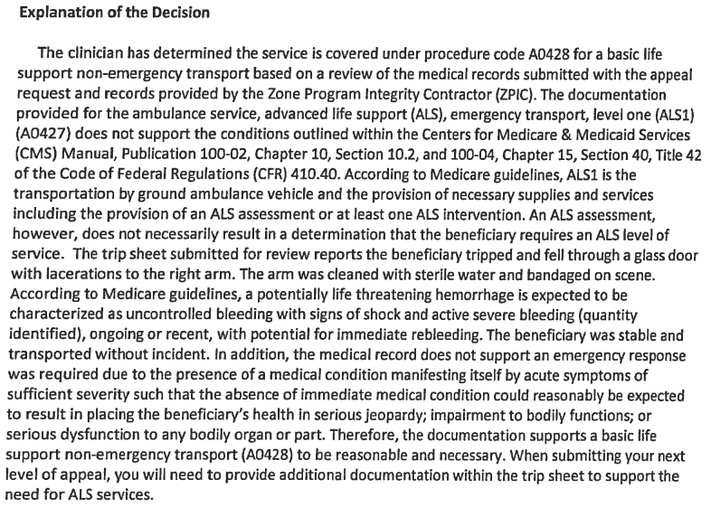
Case Study #6

Slide 30
The Problem of “Frequent Flyers”
content

Slide 31
Original Claim Revisited

Slide 32
SNF Falls
1 in 4 adults over the age of 65 will suffer a fall in any given year
Every year, falls amongst the elderly are responsible for:
25,000 deaths
2.5 million ED visits
700,000 hospitalizations
Source: Elderly Falls Prevention Legislation and Statutes, National Conference of State Legislatures, July 2018

Slide 33
Psychiatric Emergencies
content

Slide 34
content

Slide 35
Brian S. Werfel, Esq.
A.A.A. Medicare Consultant
Werfel & Werfel, PLLC
bwerfel@aol.com
(917) 570-3710

